Slide 1
HEALTHY HARVEST
Project
September 16, 2021

Slide 2
Team Members
SCRUM Master – Lakshmi Esakkimuthu
Developers – Gunashree Kannan
Sneha Annadurai
Sai Kaushik Kumaraguru
Cheekurthi Balasiva
Project Delivery Details:
Date of Assigning: 09-09-2021
Date of Delivery: 16-09-2021

Slide 3
Requirement Description
As a developer we need to develop an application which will regulate the demand and supply chain between buyers and sellers of agricultural products. So that sellers from any part of India can register and wholesale and retail buyers can check the catalogue and get the products on need basis. Apart from buyers the app will have media handles like twitter, FB and Instagram where common man can get the products from genuine sellers

Slide 4
Team Discussion on Requirements
Planned features:
Admin Portal
Common Homepage for Buyer and Seller
Buyer Homepage
Seller Homepage
Login Page for Admin, Buyer and Seller
Registration Page for Buyer and Seller

Slide 5
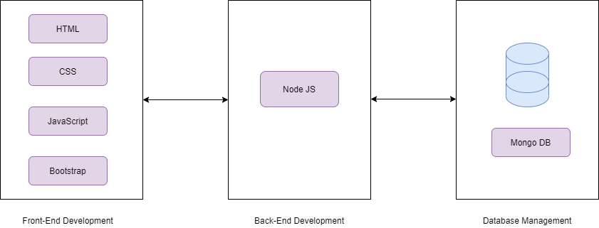
Tech Stack

Slide 6

SWOT Analysis
Strengths
Team Coordination
Front End Development
Available Resources
Weakness
Back End Development
Database integration
Opportunities
Learnt Back End development
Learnt Testing
Learnt Front end Development
Threats
Software installation
Unexpected issues

Slide 7
Work Partitioning
Team Members | Work Partition
Lakshmi Esakkimuthu | SCRUM Master Front End Developer Documentation
Gunashree Kannan | Front End Developer Back End Developer
Sneha Annadurai | Front End Developer Back End Developer
Sai Kaushik Kumaraguru | Front End Developer Front End Testing
Cheekurthi Balasiva | Front End Developer Front End Testing

Slide 8
Work Done
Team Members | Work Done
Lakshmi Esakkimuthu | SCRUM Master Admin: Login Page, Home Page, Customer List Page, Seller List Page, Order List Page, Stock Page, Settings Page Seller: Profile Page, Settings Page Documentation
Gunashree Kannan | User Home Page Seller: Home Page, Login Page, Registration Page, Order List Page, Stock Page, Product List Page Backend:
Sneha Annadurai | Buyer: Login Page, Registration Page, Home Page, Add to Cart Page Backend:
Sai Kaushik Kumaraguru | Buyer: Payment Page, View Cart Page Testing
Cheekurthi Balasiva | Testing Seller: Registration Page

Slide 9
Timeline
Date | Work Progress
09-09-2021 | Requirement Analysis, Planning and Decision on features to be added
10-09-2021 | Decided with the Tech Stack and work split up Designing of Front End Unit testing
11-09-2021 | Designing of Front End Unit testing
12-09-2021 | Designing of Front End Integration of all Pages of Admin Portal Unit testing and Integration testing
13-09-2021 | Designing of Front End Integration of All Pages in Buyer and Seller Portal Started with Back End Unit testing and Integration testing
14-09-2021 | Back End implementation Integration testing Presentation Preparation

Slide 10
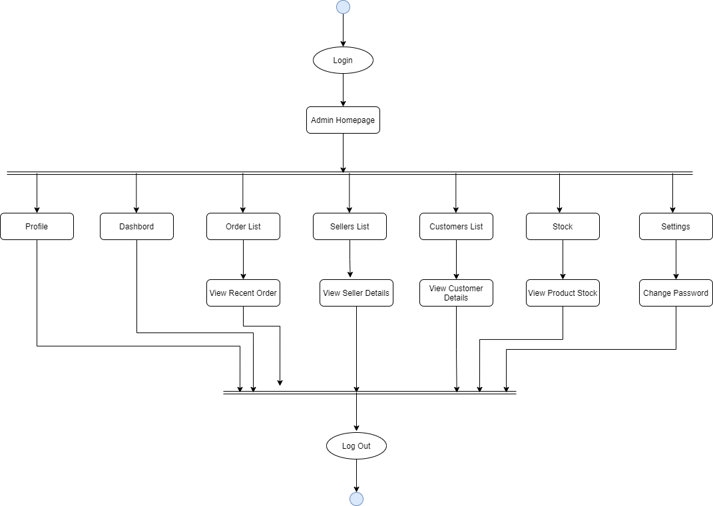
Activity Diagram for Admin

Slide 11
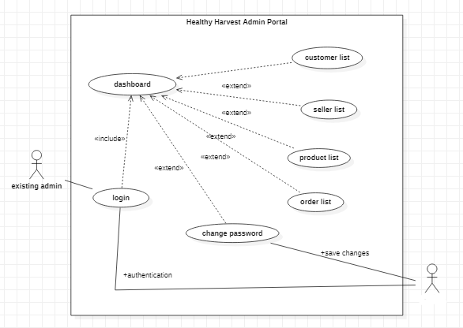
Use Case Diagram for Admin
database

Slide 12
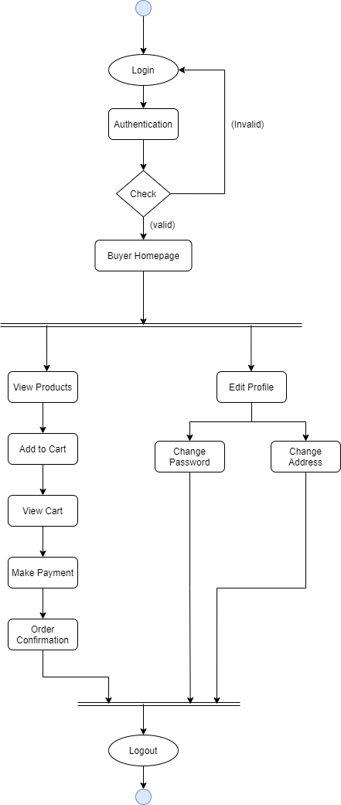
Activity Diagram for Buyer

Slide 13
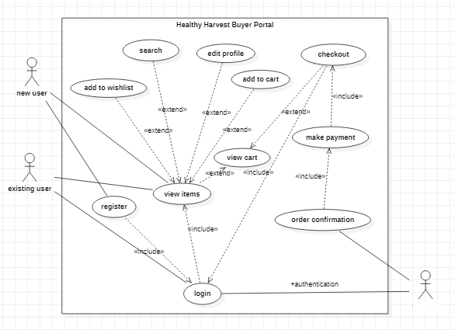
Use Case Diagram for Buyer
database

Slide 14
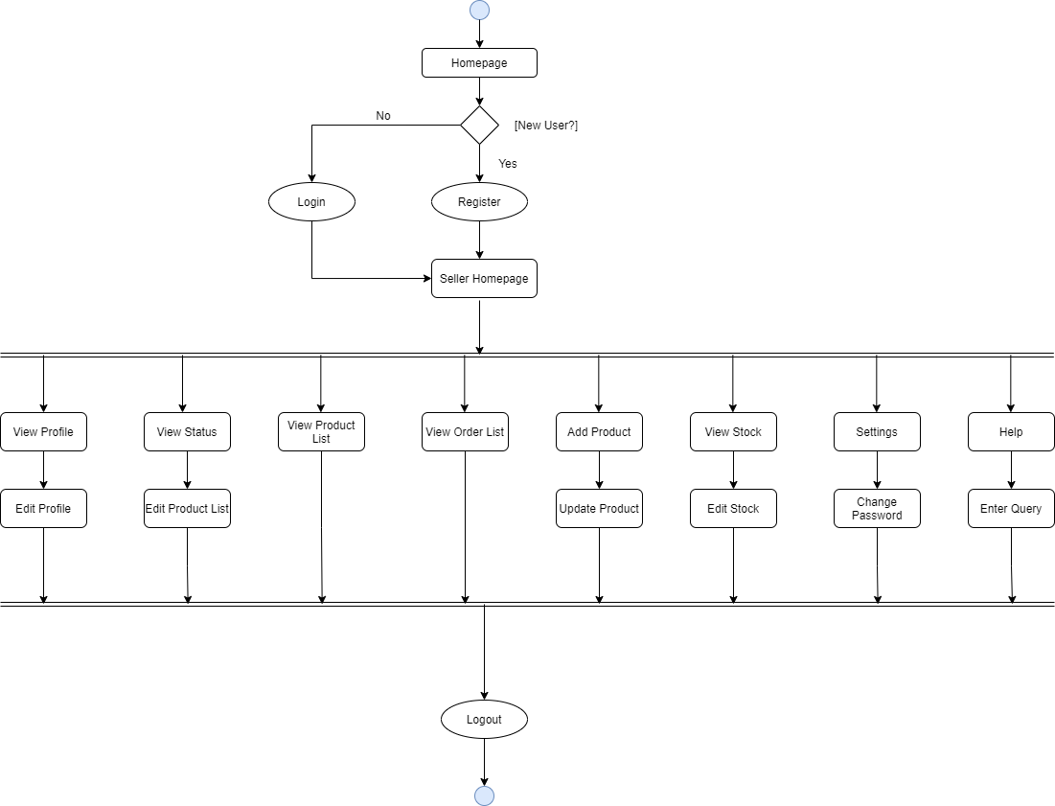
Activity Diagram for Seller

Slide 15
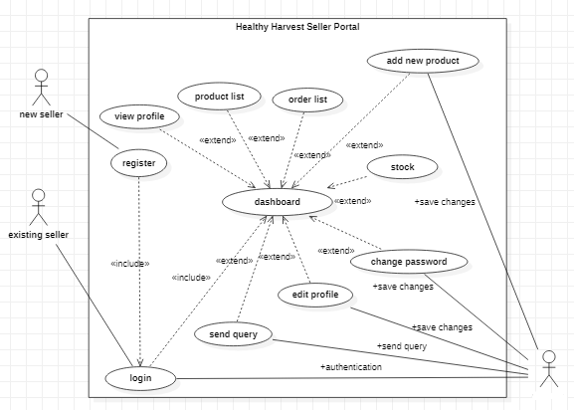
Use Case Diagram for Seller
database

Slide 16


The Product

Slide 17
Product Demo
Admin Portal
Sign in Page
Homepage
Common Homepage for Buyer and Seller
Buyer Portal:
Sign-In Page
Registration Page
Homepage
Add to Cart
Payment Page
Seller Portal:
Sign-In Page
Registration Page
Homepage

Slide 18
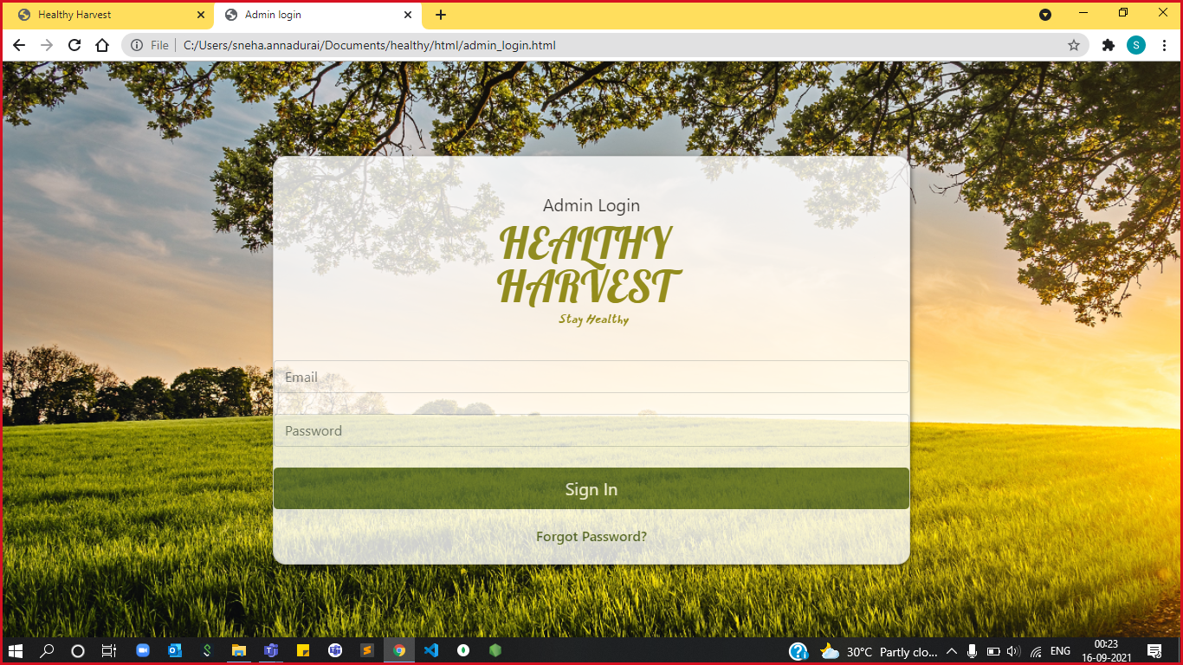

Slide 19
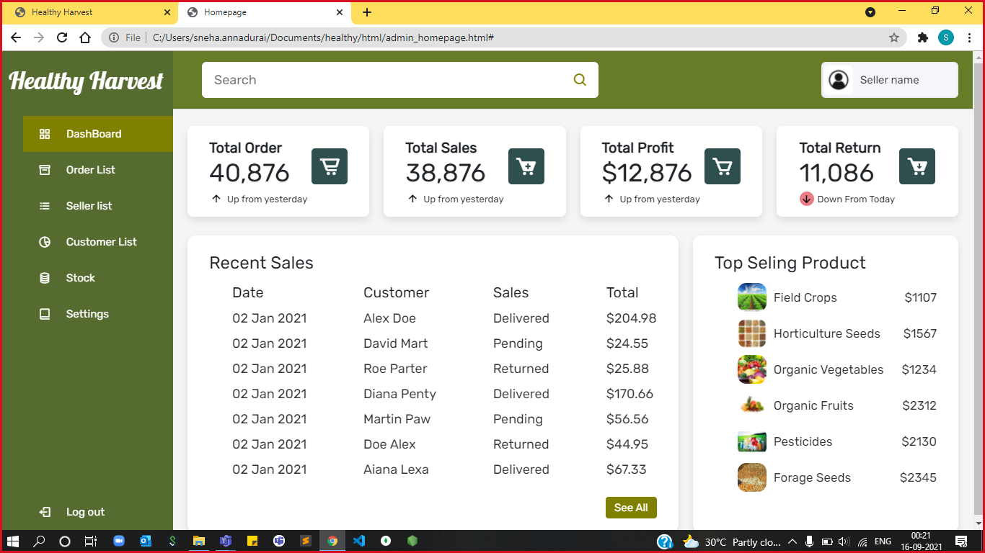

Slide 20
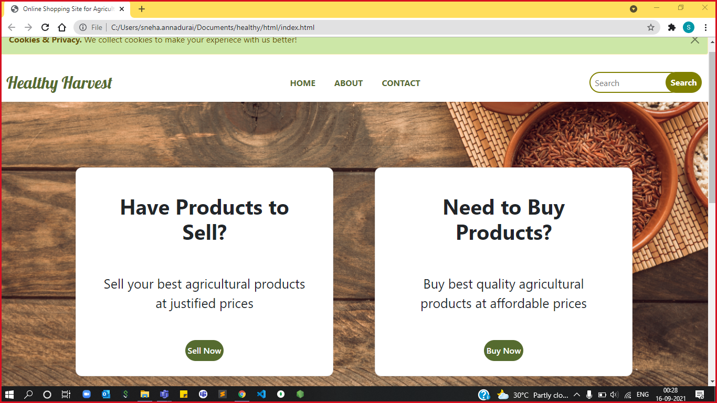

Slide 21
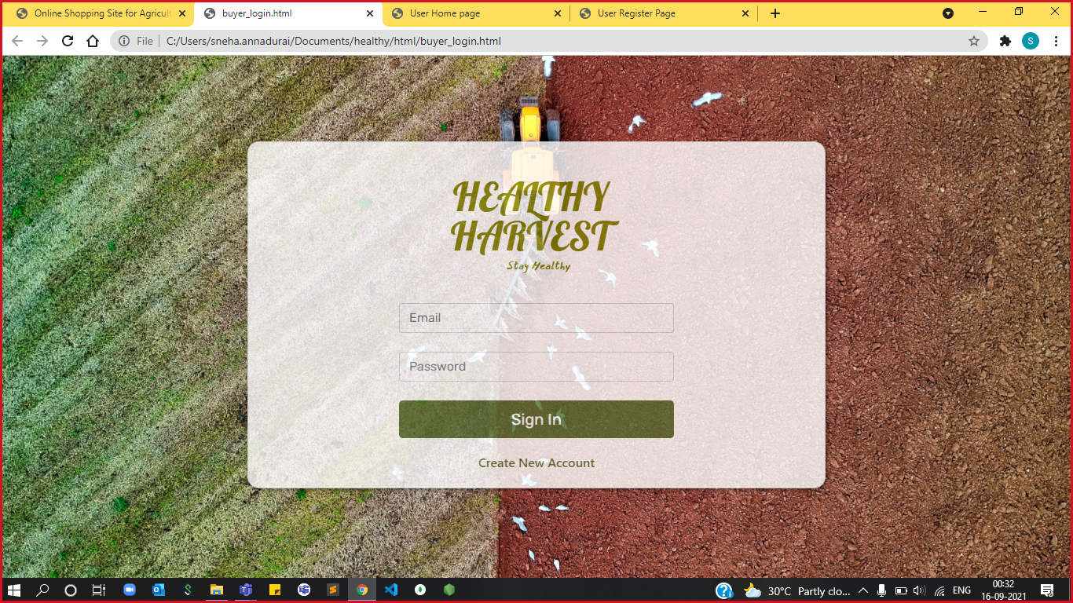

Slide 22
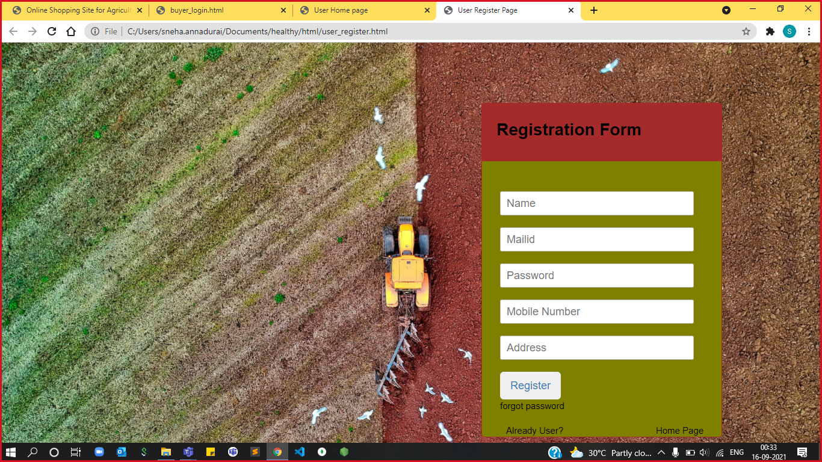

Slide 23
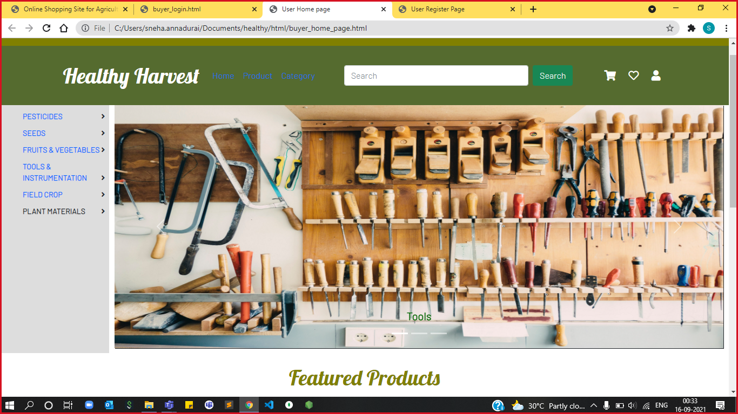

Slide 24
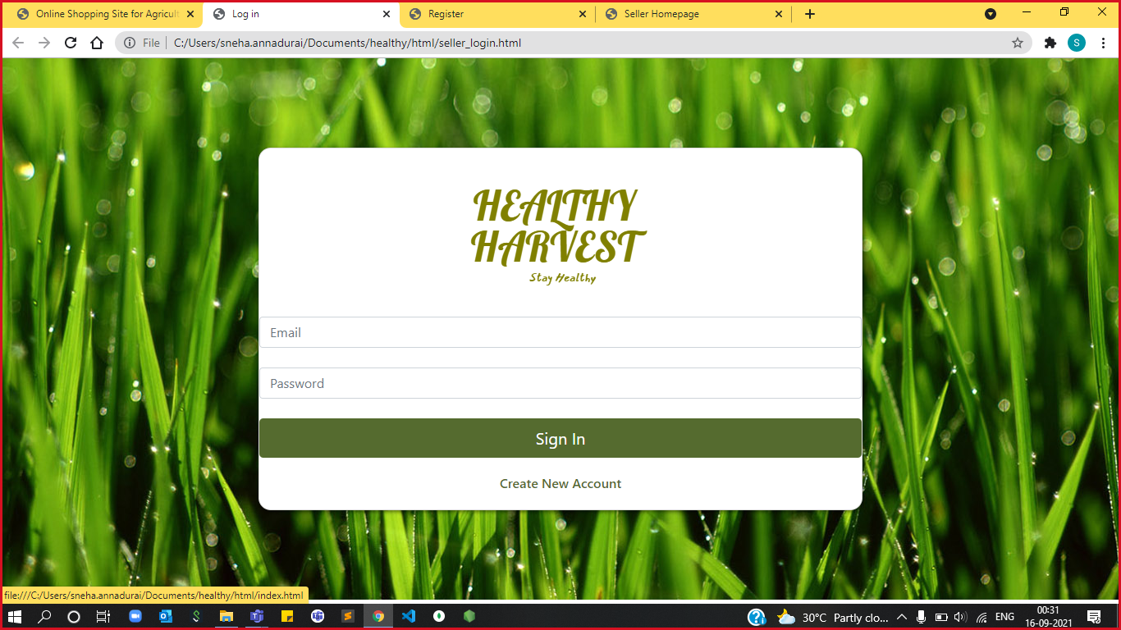

Slide 25
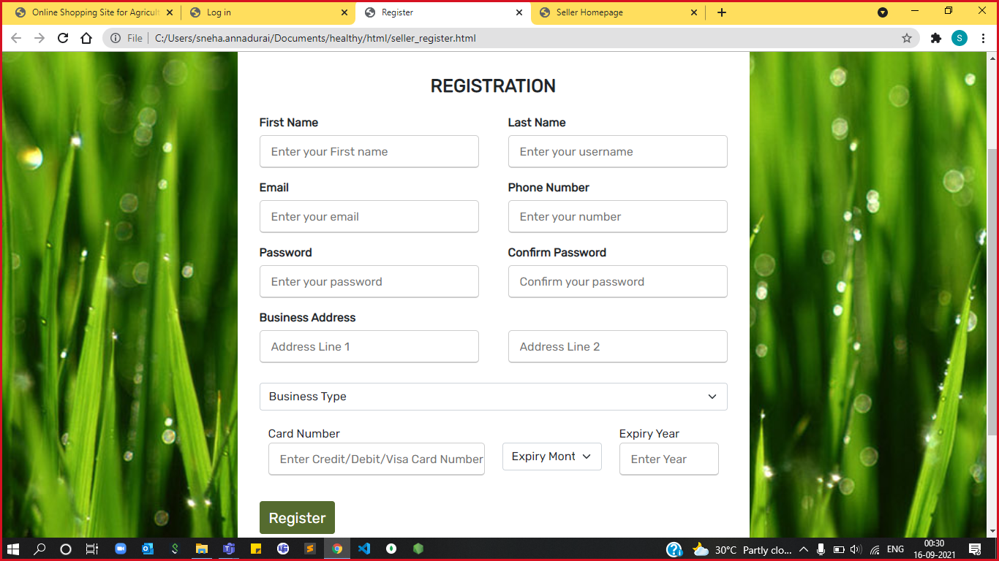

Slide 26
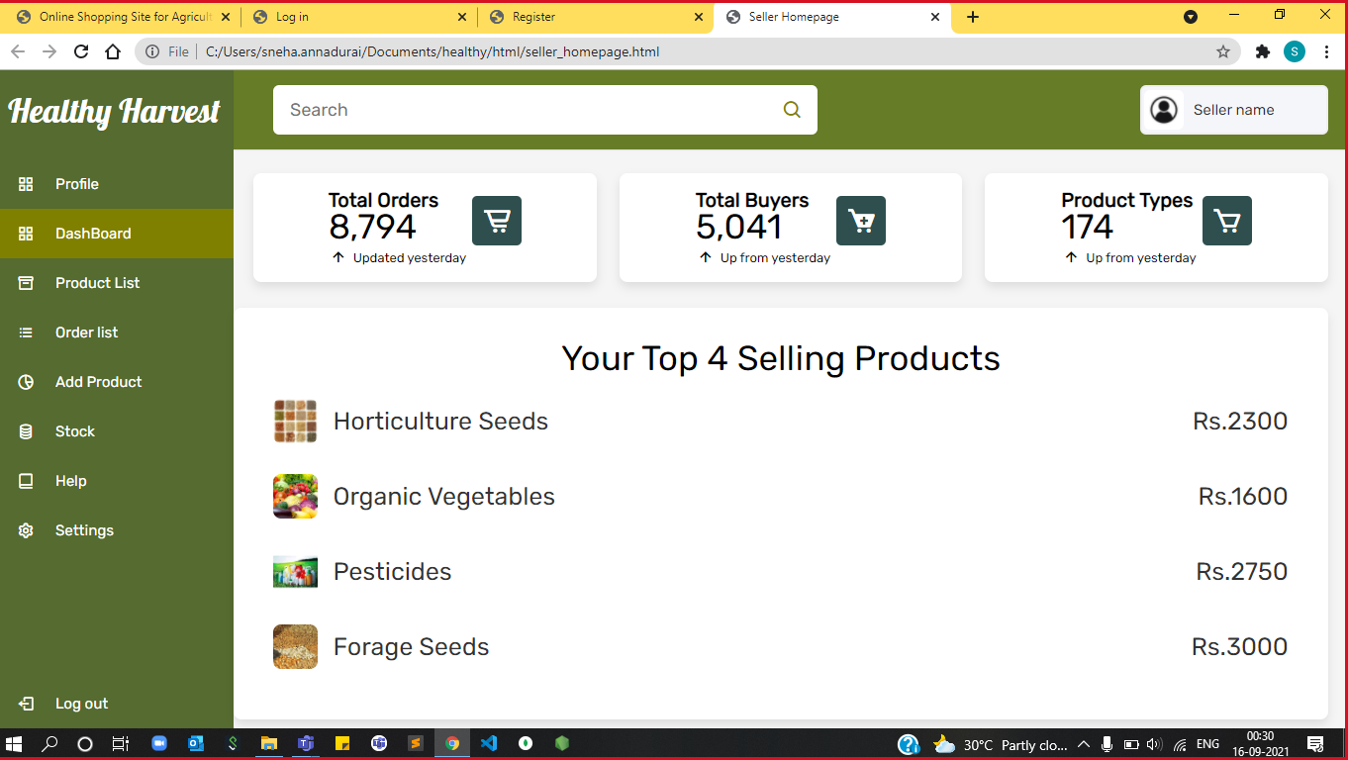

Slide 27
Testing
Unit Testing:
- done by developers for each module
Integration Testing:
- done by testers for front end
- Test Cases were maintained in Spreadsheets

Slide 28
Future Scope
Forgot Password
ID Proof Authentication
OTP Verification
Queries from admin page had to be viewed at Admin Portal
GitHub Profile link
https://github.com/HealthyHarvest2021

Slide 29

Thank you

